Slide 1
Regeneration
Chapters 4
J. M. Simmons, Optical Network Design and Planning, Optical Networks,
© Springer International Publishing 2014

Slide 2
Agenda
Introduction
Factors that Affect Regeneration
Routing with Noise Figure as the Link Metric
Regeneration Strategies
Regeneration Architectures

Slide 3
Introduction
In the planning process:
I- Selecting a path each demand
II-Selecting the regeneration sites for the demand, if
any by “cleans up” the optical signal
III- Clean up ≡ reamplifying, reshaping, and retiming
referred to as “3R” regeneration.
IV- Paths are usually selected to minimize the amount
of required regeneration, to reduce the network
cost and increase the path reliability.

Slide 4
Factors affecting Regeneration
Optical Impairments
Network Element Effects
Transmission System Design
Fiber Plant Specifications
Mitigation of Optical Impairments
Mixed Line-Rate Systems
System Regeneration Rules

Slide 5
Optical Impairments
Noise: Optical signal-to-noise ratio (OSNR)
Linear:
Polarization-mode dispersion (PMD)
Chromatic dispersion, or simply dispersion (CD)
Nonlinear:
self-phase modulation (SPM)
Cross-phase modulation (XPM)
Four-wave mixing (FWM)

Slide 6
Network Element Effects
Deleterious effects (suffering signal when it gets transited an optical-bypass-enabled network element):
Optical filtering effect
Crosstalk caused by “leakage” within a switching element
Polarization dependent loss
Non-flat dispersion level occur across the transmission band
Limiting the cascadability As optical-bypass technology has matured, many commercial systems support optical bypass of up to 10 (backbone) or 20 (metro-core) network elements prior to requiring regeneration.
The number of network elements bypassed is not usually the limiting factor in determining where regeneration is needed!

Slide 7
Transmission System Design
Characteristics of the transmission system:
Amplification type (Raman or EDFA technology)
Spacing between wavelengths (Closer spacing reduces the reach)
Launched power (Increasing the launched power increases the optical reach, up to a point, i.e. there is an optimum power)
Signal modulation format (Coherent or direct detection)
FEC (Stronger coding Longer reach
state-of-the-art FEC provides a net coding gain of roughly
10–11 dB at a post-FEC BER of 10⁻¹⁵, with 20% overhead

Slide 8
Fiber Plant Specifications
Characteristics of the physical fiber plant:
Amplifier huts distances (OSNR decreases more sharply for 100-km amplifier spacing as compared to 80-km spacing, for a given amplification type)
Type of fiber in the network, the most commonly used fiber types are: non dispersion-shifted fiber (NDSF) or
non-zero dispersion-shifted fiber (NZ-DSF)
Older fiber plants may include dispersion-shifted fiber (DSF).
Dispersion is helpful in combatting these impairments

Slide 9
Mitigation of Optical Impairments
Digital coherent technology allows for the compensation of
linear impairments such as chromatic dispersion and PMD in the receiver and
Nonlinear effects to some extend (limited by computational complexity)
via signal processing.
Ongoing research into using coherent detection to counteract some of the nonlinear effects more extensively!

Slide 10
Mixed Line-Rate Systems
There are not heterogeneous line rates on one fiber.
Significant performance penalty for DP-QPSK wavelengths due to
XPM induced by adjacent legacy 10-Gb/s wavelengths.
Coherent systems require little to no exogenous dispersion compensation because the coherent receiver itself is capable of compensation, whereas legacy 10-Gb/s systems typically have spools of dispersion compensating fiber strategically deployed along a link
The presence of dispersion can be helpful in mitigating some of the deleterious nonlinear interchannel effects

Slide 11
System Regeneration Rules
Regenerate optical signal in a connection if
The OSNR is below certain level
The accumulated dispersion is above certain compensable value
The accumulated PMD is above certain value
The number of network elements optically bypassed is greater than certain number
Connections are constantly brought up and down in a network, either due to changing traffic patterns or due to the occurrence of, or recovery from, failures; thus, it is important that the regeneration rules to be independent of the number of active channels on a fiber.

Slide 12
Routing with Noise Figure as the Link Metric
Assumption: low enough signal power or high enough dispersion levels => negligible nonlinear optical impairments (also neglegible PMD)
As an optical signal propagates down a fiber link, its OSNR degrades. The noise figure (NF) of a link is defined as the ratio of the OSNR at the start of the link to the OSNR at the end of a link, i.e.,
Numerous factors affect the NF of a link:
Type of amplification: Raman amplification produces lower NF than EDFAs.
Large fiber attenuation
Large splicing losses
Longer span distances (i.e., the distances between amplifier huts) generally increase the NF.
The NF is also affected by the fiber type of the link.

Slide 13

NF calculation
Example:
Loss compensated
by amplification
in each span

Slide 14
Network Element Noise Figure
Each network element, such as a ROADM, has an associated NF.
To account for this effect in the routing process, the link metric should be adjusted based on the type of equipment deployed at either end of the link.
Add half of the NF of the elements at the endpoints

Slide 15
Impact of the ROADM without Wavelength Reuse
Such elements are typically little more than an optical amplifier with a coupler/splitter for adding/
dropping traffic at the node.
Example:
Assume that the optical reach is 2,000 km. The ROADM at Node B does not have wavelength reuse. A signal from Node B to Node Z has a level of noise as if it originated at Node A, and thus, needs to be regenerated at Node C

Slide 16
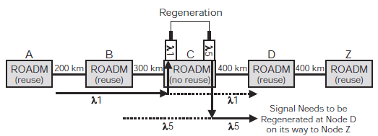
Impact of the ROADM without Wavelength Reuse, cont’d
Example: The desired connection is between Nodes A and Z?
Assume that the optical reach is 1,000 km. If the connection is regenerated at Node C, which has a no-reuse ROADM, will it need to be regenerated again at Node D?
Regeneration is generally not recommended at a node with a no-reuse ROADM

Slide 17
Regeneration Strategies
There are several approaches to managing regeneration in a network.
Three strategies are presented here, where the three differ with respect to flexibility, operational complexity, and cost:
Islands of Transparency
Designated Regeneration Sites
Selective Regeneration

Slide 18
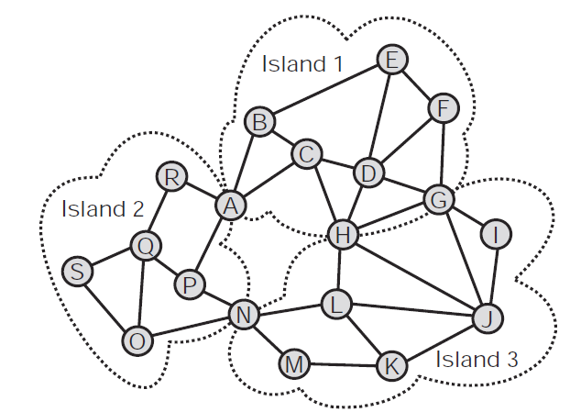
Islands of Transparency
This network is partitioned into some (three in the figure) islands of transparency.
Any traffic within an island
does not need regeneration.
Any traffic between
islands does require
regeneration

Slide 19
Designated Regeneration Sites
Designating a subset of the nodes as regeneration sites, and allows regeneration to occur only at those sites
Either the designated regeneration sites are equipped with O-E-O equipment such that all traffic that transits them needs to be regenerated, or they have optical-bypass equipment so that regeneration occurs only when needed.
The routing process must be modified to take into account the limited number of sites that can provide regeneration. To ensure that a valid path is found that transits the necessary regeneration sites, one can use a graph transformation discussed in the routing chapter (Ch. 3).

Slide 20
Strategies for Determining the Set of Regeneration Sites
Routing all of the forecasted traffic over its shortest path. A greedy type of strategy then is employed where nodes are sequentially picked to be regeneration sites based on the number of paths that become feasible with regeneration allowed at that site.
Utilizing the network topology rather than a traffic forecast, is based on connected dominating sets (CDS)
A dominating set of a graph is a subset of the nodes, S, such that all nodes not in S are directly connected to at least one of the nodes in S. The dominating set is connected if there is a path between any two nodes in S that does not pass through a node not in S.

Slide 21
Strategies for Determining the Set of Regeneration Sites, cont’d
The first step of the CDS methodology is to create the reachability graph. All network nodes are included in the graph, and two nodes are connected by a link only if there is a regeneration-free path between them in the true topology. A minimal CDS is found for the reachability graph, using heuristics
The goal of the CDS strategy is to minimize the number of nodes selected as re-generation sites.

Slide 22
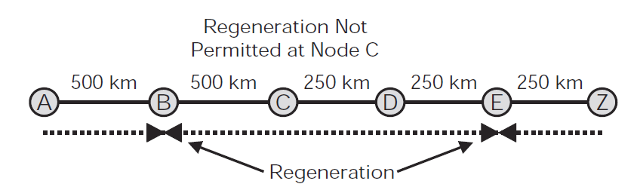
Advantages and Disadvantages of Designated Regeneration Sites
Designated-regeneration-site architecture may result in extra regenerations.
Example:
Assume that the optical reach is 1,000 km. A connection between Nodes A and Z is ideally regenerated in just Node C. However, because it is assumed that regeneration is not permitted at this site, the connection is regenerated at both Nodes B and E instead

Slide 23
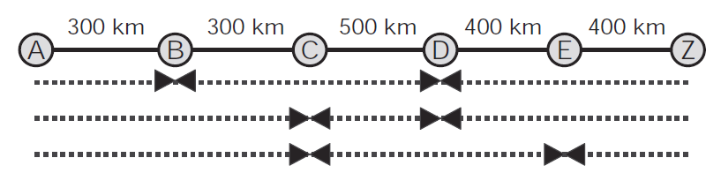
Selective Regeneration
In real-time planning, the amount of available equipment at each node should be considered, where regeneration is favored in the nodes that have more free equipment:
Example:
Assume that the optical reach is 1,000 km, and assume that regeneration is permitted at any node. A connection between Nodes A and Z can be regenerated at Nodes B and D, at Nodes C and D, or at Nodes C and E

Slide 24
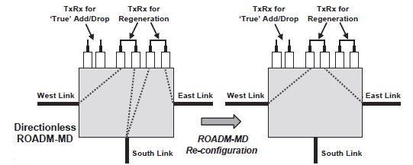
Regeneration Architectures
I- Back-to-Back WDM Transponders

Slide 25
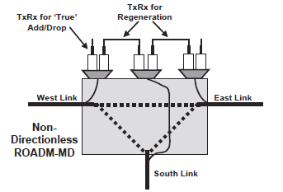
Regeneration Architectures
I- Back-to-Back WDM Transponders

Slide 26
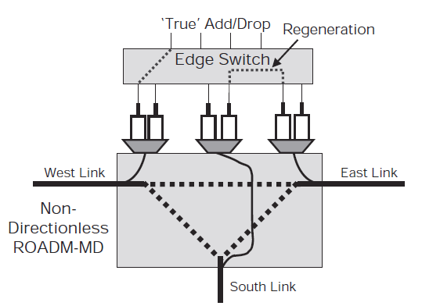
Regeneration Architectures, cont’d

Slide 27
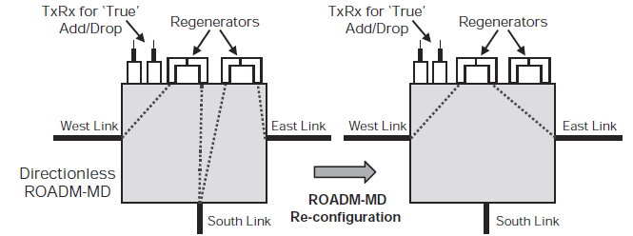
Regeneration Architectures
II- Regenerator Cards

Slide 28
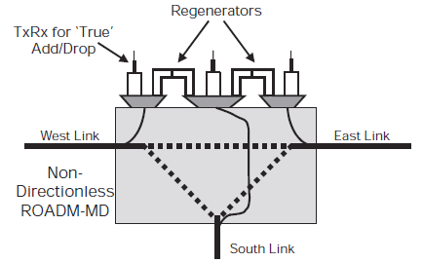
Regeneration Architectures, cont’d

Slide 29
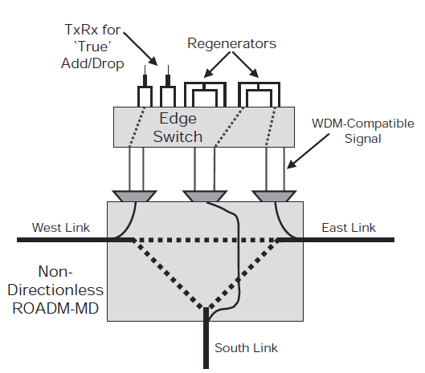
Regeneration Architectures, cont’d

Slide 30
Enough for today!
Questions?

